Slide 1
Negative Number Representation

Slide 2
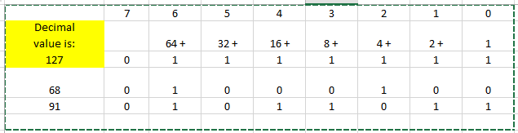

Slide 3
The Most Significant bit is always zero for positive numbers
Can we use that MSB as an indicator of negative number
MSB = 0 , positive number
MSB=1 means negative number ?

Slide 4
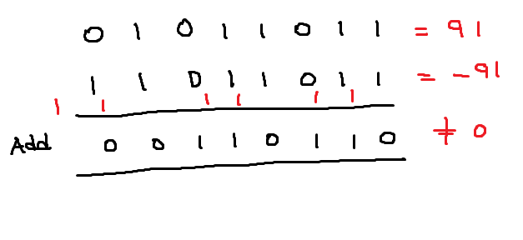

Slide 5
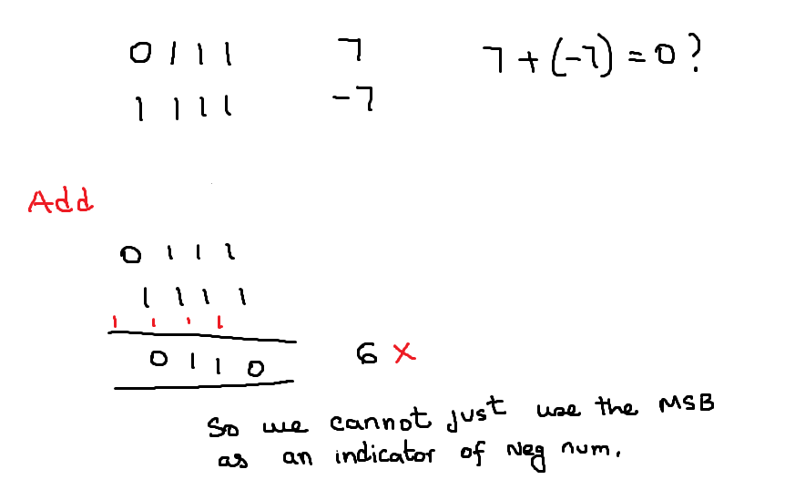

Slide 6
Algorithm to store Negative numbers
Say We want to store –X .
Take the positive number = X
Convert the positive number to 1s Complement = Say Y
Add 1 to Y. The result is your negative number of -X

Slide 7
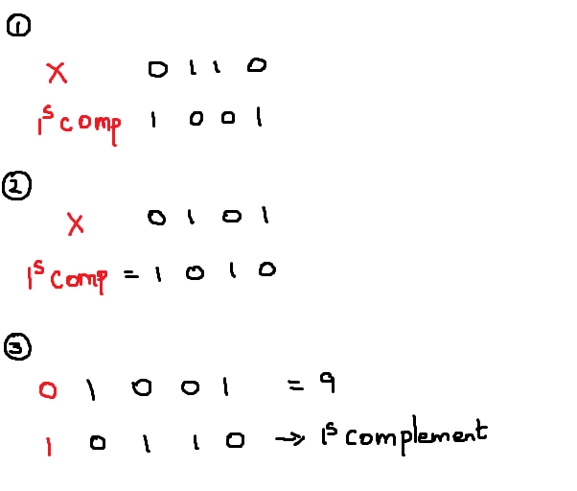
Convert positive number to 1s Complement

Slide 8
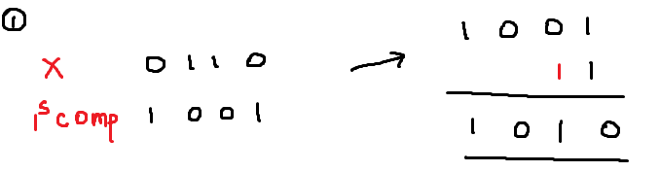
Add 1 to 1s Complement

Slide 9
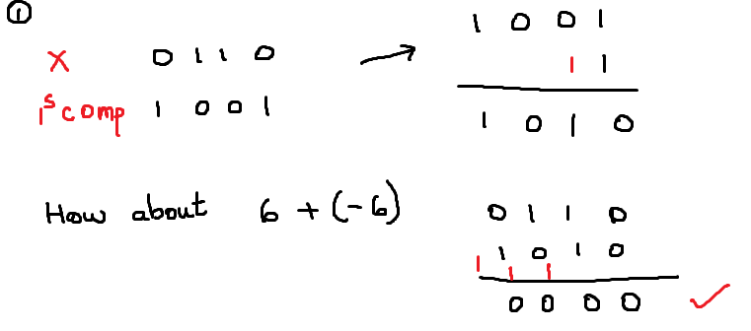
6 + ( -6) = 0 ?

Slide 10
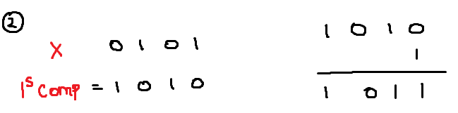
Add 1 to 1s Complement

Slide 11
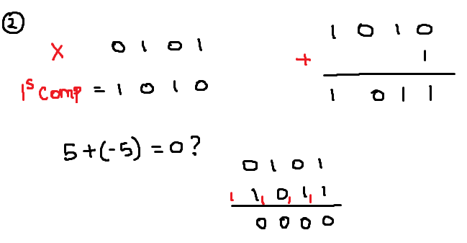
5 + ( -5)

Slide 12
